Slide 1
Web Crawler Recognition Model
Convolutional Neural Network
JMU University
Repoter：Lin

Slide 2
CONTENTS
Project background and significance
01
02
Convolutional Neural Network Structure
03
Data preprocessing
04
Partial source analysis
05
Project introduction

Slide 3
PART 01
Project background and significance

Slide 4
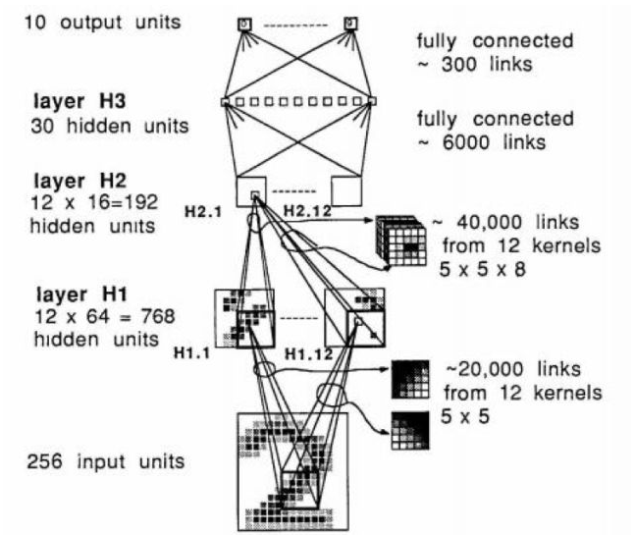
01
Project background and significance
1.This project aims to solve the problem of mismatch between data sets and actual problems. Users can get the data set model they want to identify through independent training to solve their actual problems. This project USES tensorflow, pyqt, and tensorboard.
2.At present, users may not be able to find data sets on the Internet when they are doing image recognition. The purpose of this project is to deal with such problems. Users can crawl images through web crawlers and retrain images as data sets to obtain an image data set that users want to process.

Slide 5
PART 02
Convolutional Neural Network Structure

Slide 6
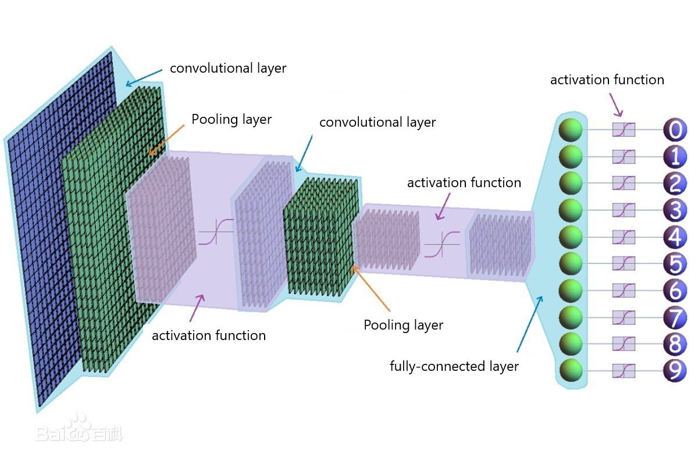
02
Convolutional Neural Network Structure
1. Convolutional neural network includes convolutional layer, pooling layer, full-connection layer and activation function

Slide 7
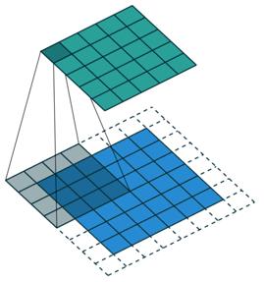
02
Convolutional Neural Network Structure
2. The convolution layer contains important concepts and the purpose of the convolution layer
Purpose：The convolution kernel is used to scan the image line by line (or across lines, depending on the parameters) and finally extract the features in the image
Important concepts：local receptive fields and shared weights

Slide 8
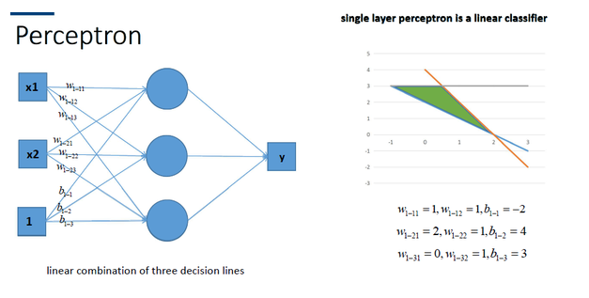
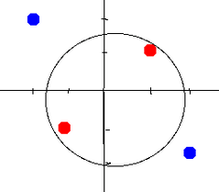
02
Convolutional Neural Network Structure
3. The function of the activation function and the important model
important model: sigmod;tanh(双曲正切函数)；ReLu
function:Convert multiple linear inputs into nonlinear relationships,Increase the nonlinear expression ability of the model

Slide 9
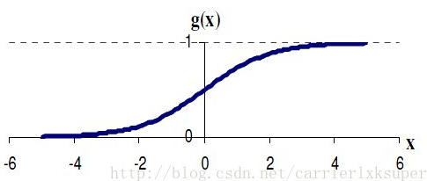
02
Convolutional Neural Network Structure
4. sigmod
disadvantages：When the input value is small or large, the output curve is basically a straight line.

Slide 10
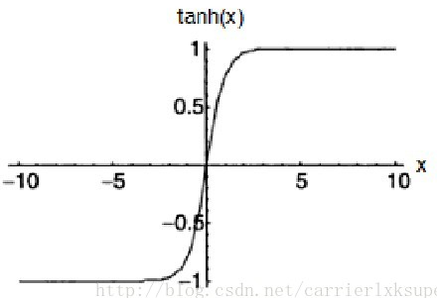
02
Convolutional Neural Network Structure
5. tanh
disadvantages：When the input value is small or large, the output curve is basically a straight line.

Slide 11
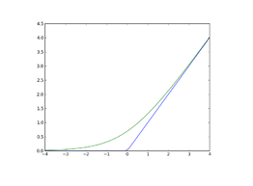
02
Convolutional Neural Network Structure
6. ReLu
advantages:No gradient disappears and the convergence speed is fast.
disadvantages：It is fragile and easy to die in training. If a parameter is 0 in reverse propagation, the following parameter will not be updated.

Slide 12
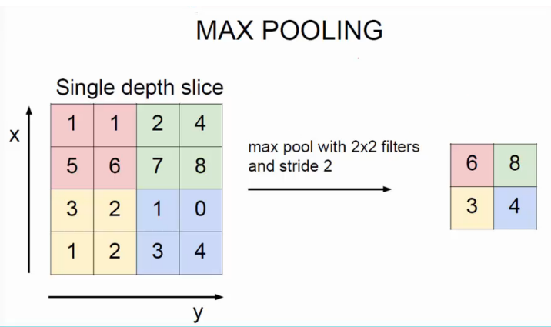
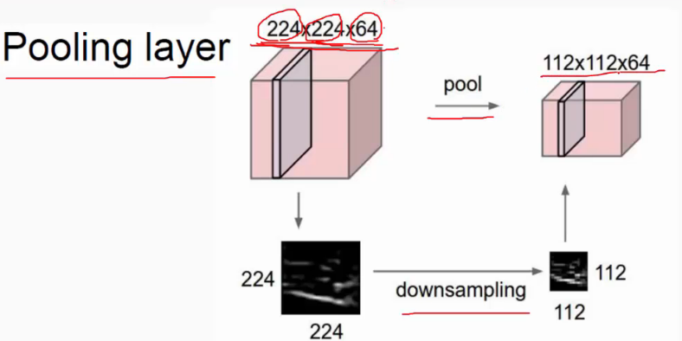
02
Convolutional Neural Network Structure
7. The purpose and category of the pooling layer
Purpose：On one hand, the input feature graph is compressed to make the feature graph smaller and simplify the computational complexity of the network. On the one hand, feature compression is carried out to extract the main features
Category:Mean-Pooling and Max Pooling

Slide 13
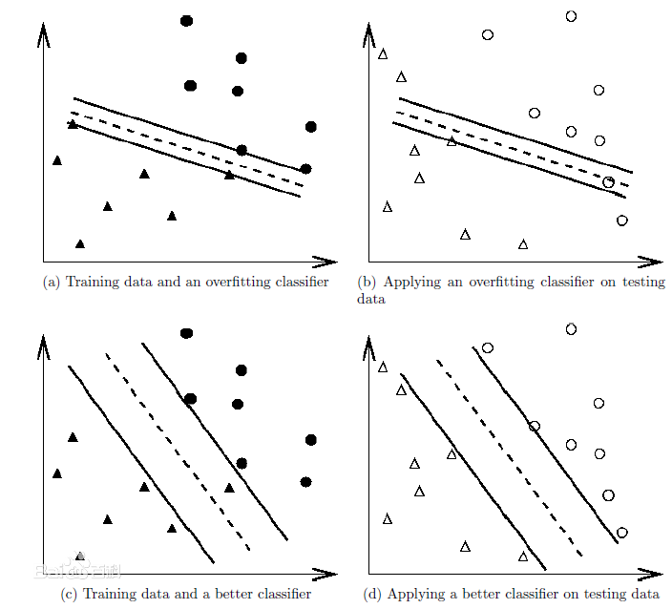
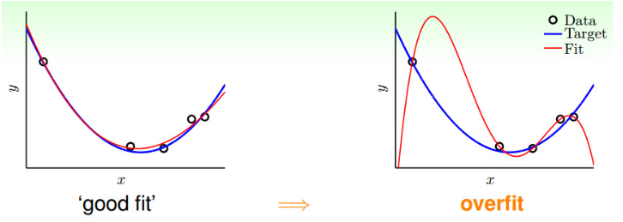
02
Convolutional Neural Network Structure
a,b overfitting, c,d not overfitting
The solution:During the CNN training process, dropout is to randomly reset the weight of some neurons to 0 during each training process, that is, to make some neurons fail. In this way, the number of parameters can be reduced and overfitting can be avoided
8. Overfitting

Slide 14
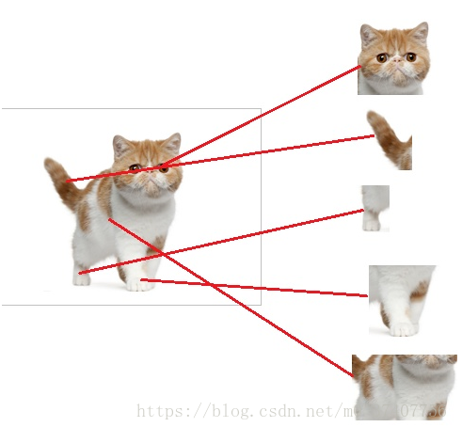
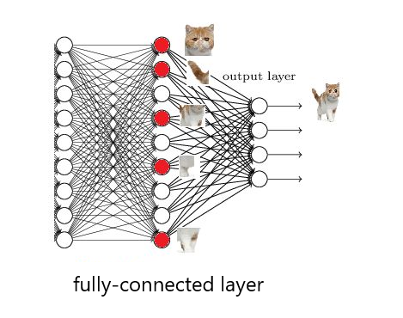
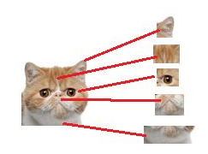
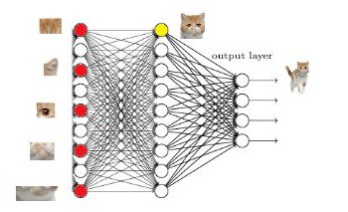
02
Convolutional Neural Network Structure
8. The purpose and definition of the fully-connected layer
Purpose：Integrate features and categorize
Category:Mean-Pooling and Max Pooling

Slide 15
PART 03
Data preprocessing

Slide 16
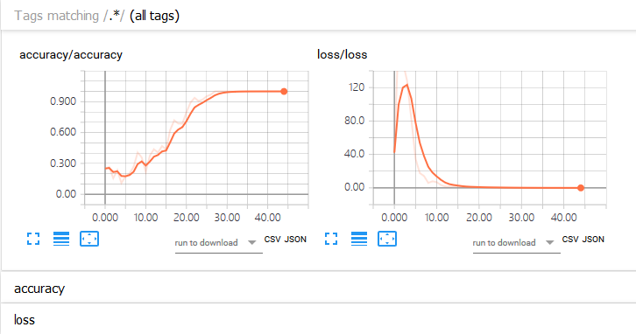
03
Data preprocessing
1. Data acquisition：Web crawler
2.The data processing：Convert all image formats to 100*100 format (otherwise the number of matrices output by the convolution layer will be different)
3.The data analysis:Tensorboard was used for data analysis, with iteration number as the horizontal coordinate and loss value and accuracy as the vertical coordinate.

Slide 17
PART 04
Partial source analysis

Slide 18
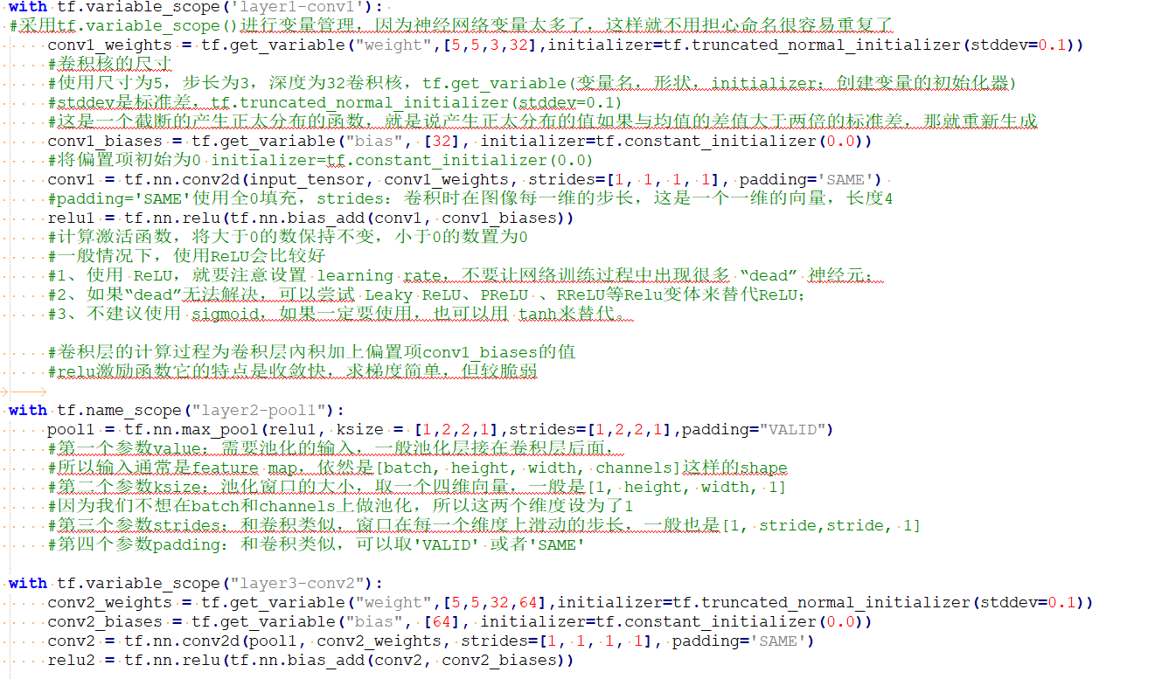
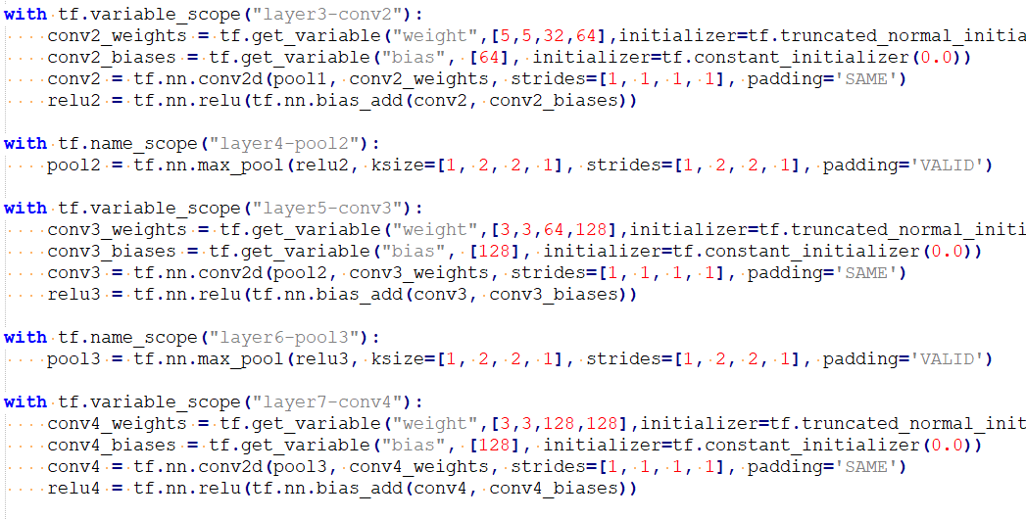
04
Partial source analysis
1. Convolutional neural network source code analysis

Slide 19
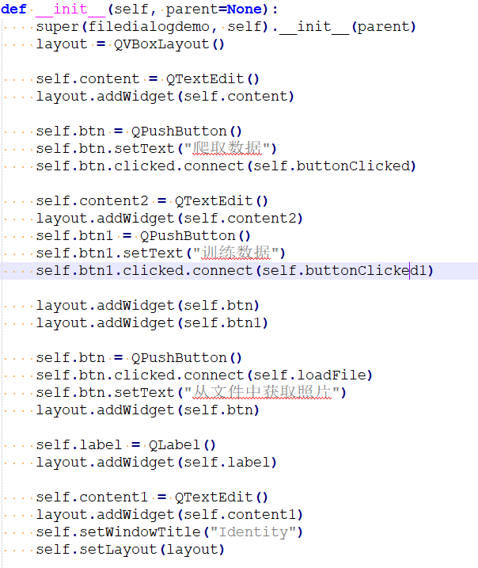
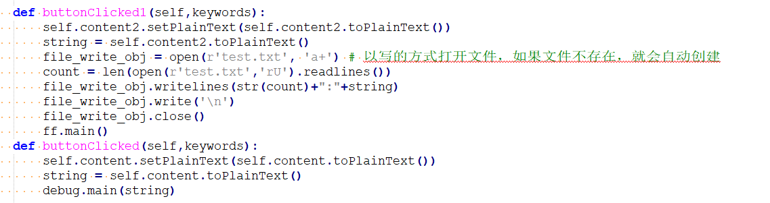
04
Partial source analysis
2. Pyqt source code analysis

Slide 20
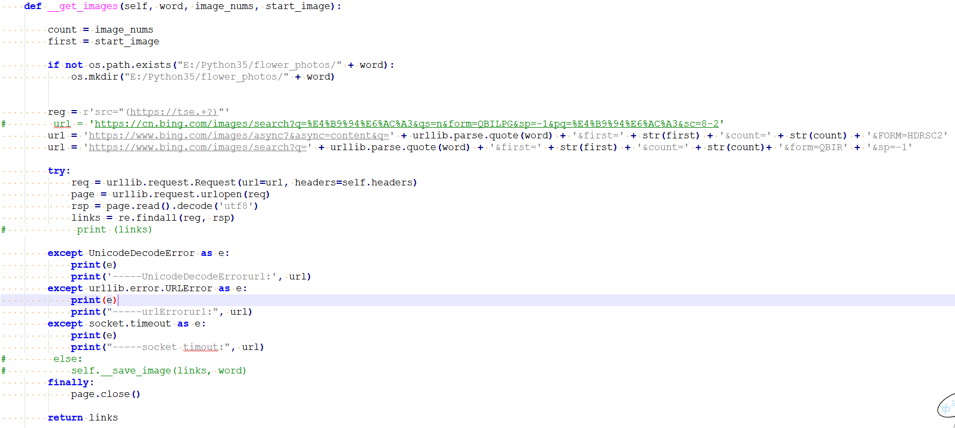
04
Partial source analysis
2. Web crawler source code analysis

Slide 21
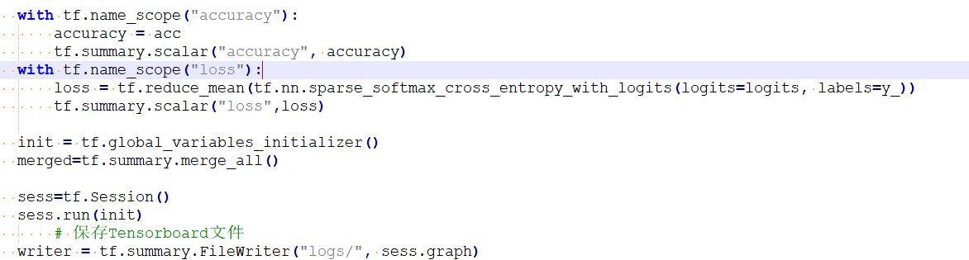
04
Partial source analysis
3. Data preprocessing

Slide 22
PART 05
Project introduction

Slide 23
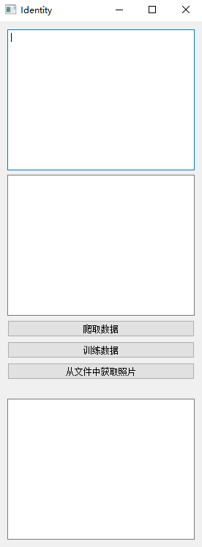
05
Project introduction
3.1 Program interface
Introduction of interface:
(a) Based on pyqt, the project interface realizes data crawling, data training and image recognition
(b)The purpose of this experiment is to create a data set that can be updated and trained, so as to train and recognize pictures at any time

Slide 24
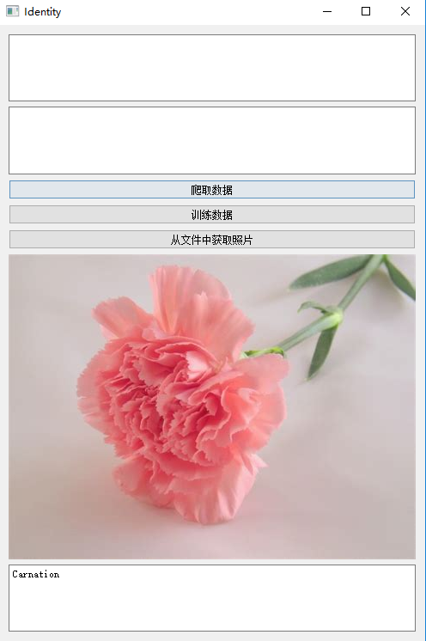
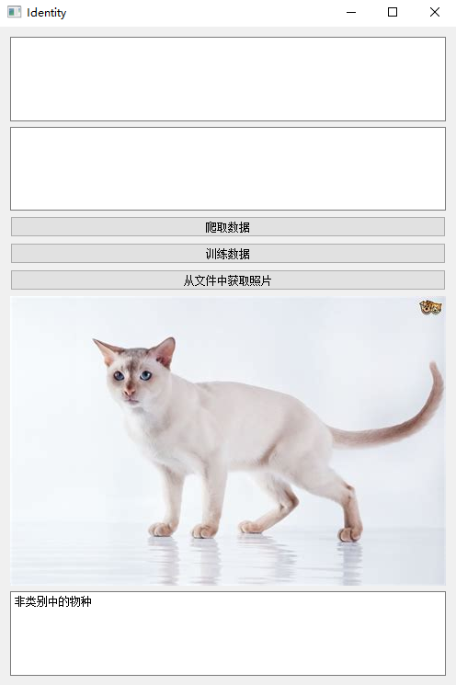
05
Project introduction
3.1 Identification process
Categories owned in the training set
Categories that are not in the training set

Slide 25
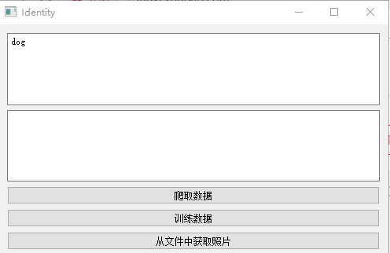
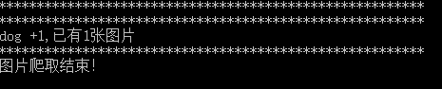
05
Project introduction
3.1 Data crawl
Use a web crawler to crawl images on bing
Web crawler in the background, because it is a test, so only climb a picture

Slide 26
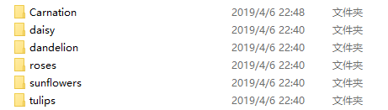
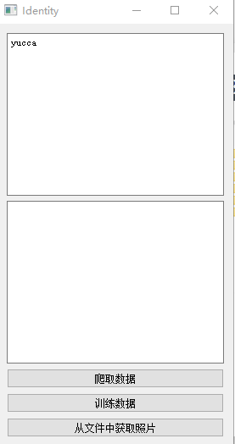
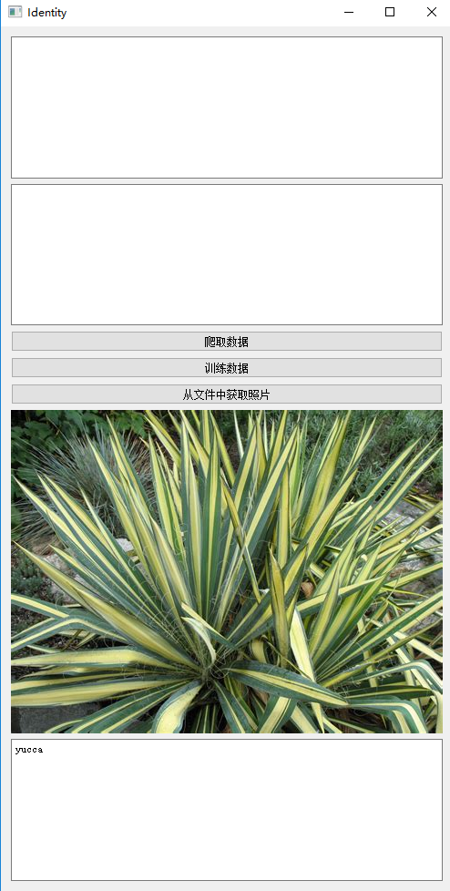
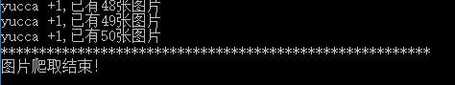
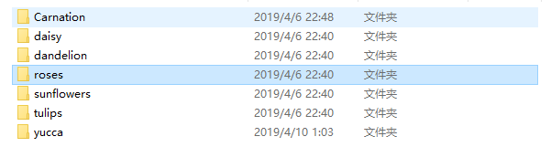
05
Project introduction
3.1 Data training
Use crawler to crawl to get pictures, and then carry out the classification after training

Slide 27
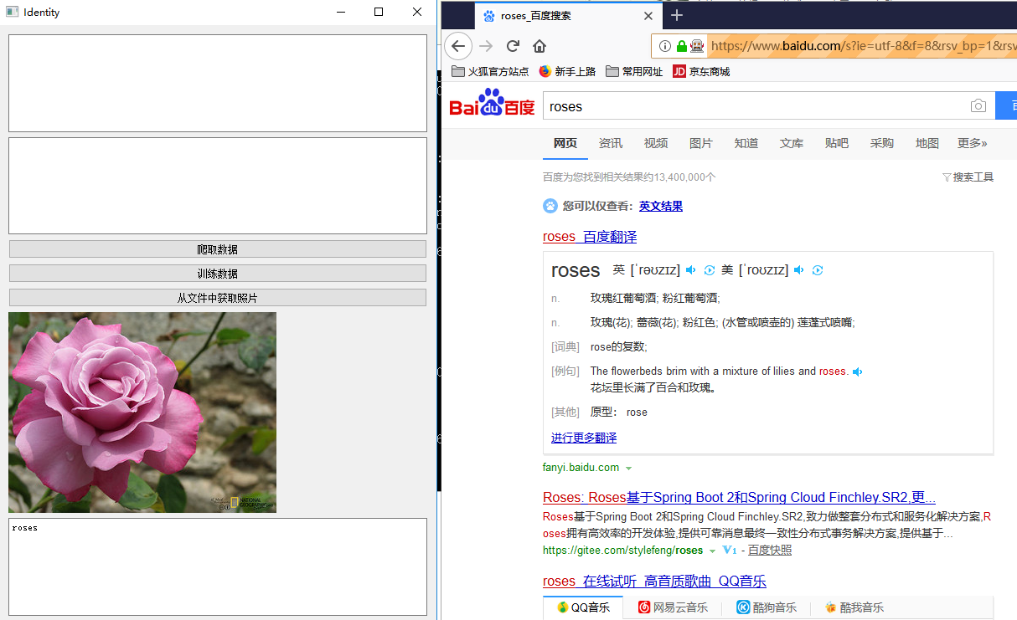
05
Project introduction
3.2 Search
Use crawlers to search for data

Slide 28
THANKS
repoter：Lin

